Slide 1
Genius Group
HACKHATHON
Members:
1.Mahendra Kumar
2. Ashutosh Sharma
3. Krupali Mundhwa
4. Priyanka Jain

Slide 2

INTERNET OF THINGS
The Internet of Things(IOT) is the N/W of physical devices, vehicles, home appliance & another items embedded wit electronics, software, sensors, actuators, and connectivity which enables these objects to connect and exchange Data.
The IOT allows objects to be sensed or controlled remotely across

Slide 3
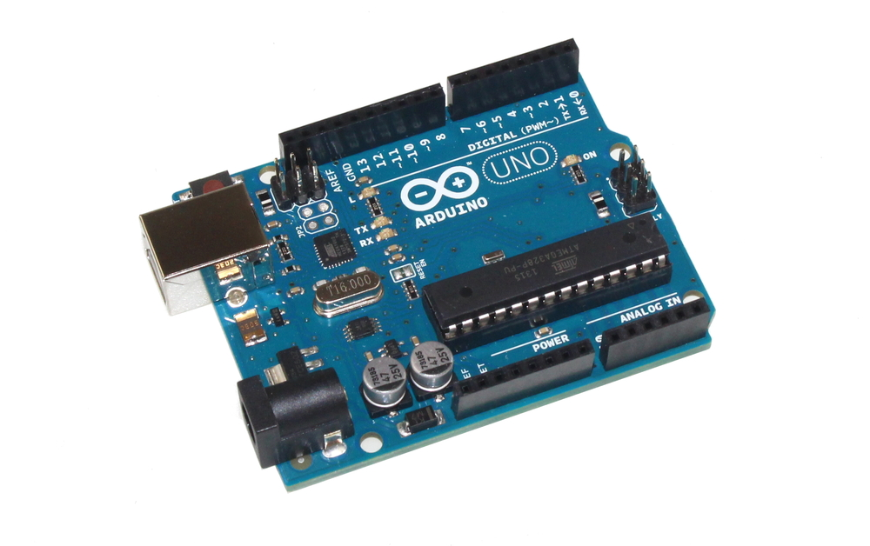
Arduino Uno
The Arduino project provides the Arduino integrated development environment (IDE).
A program written with the IDE for Arduino is called a sketch.
Minimal Arduino C/C++ program consist of only two functions
1. Setup()
2. Loop()

Slide 4
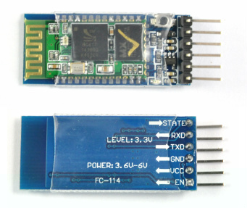
HC 05 Bluetooth Module
HC‐05 module is an easy to use Bluetooth SPP (Serial Port Protocol) module, designed for transparent wireless serial connection setup.
Hardware Features:
Typical ‐80dBm sensitivity.
Up to +4dBm RF transmit power.
3.3 to 5 V I/O.
PIO(Programmable Input/output) control.

Slide 5
Introduction
In this project we are going to make a home automation system using ESP8266 WiFi module and Arduino Uno.
Using this we will be able to control lights, electric fan and other home appliances through a web browser using your PC or mobile. These AC mains appliances will be connected to relays which are controlled by the Arduino.
ESP8266 and Arduino together acts as a Web Server and we will send control commands through a Web Browser like Google Chrome or Mozilla Firefox. ESP8266 is the one of the most popular and low cost wifi module available in the market today.
You can ready more about it here, ESP8266 – WiFi SoC.
Sept 23, 2017
Chartered Institute of Technology, Abu Road
17

Slide 6
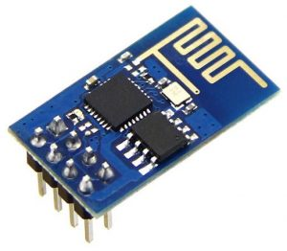
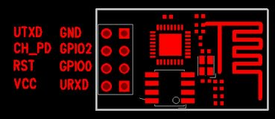
ESP-01 ESP8266 Module
It can act as both Wi-Fi access point as well as a WiFi client. It is pre-programmed with AT commands, so we can easily access and configure it using a microcontroller.
ESP8266 runs on 3.3V and its input pins are not 5V tolerant. So we need to reduce the 5V output of the Arduino Tx pin to 3.3V by using voltage dividing resistors to connect to Rx pin of ESP8266 module. Arduino TTL input pins will detect 3.3V as logic high, so we can directly connect 3.3V output of ESP8266 Tx to Arduino Rx pin
Sept 23, 2017
Chartered Institute of Technology, Abu Road
17

Slide 7
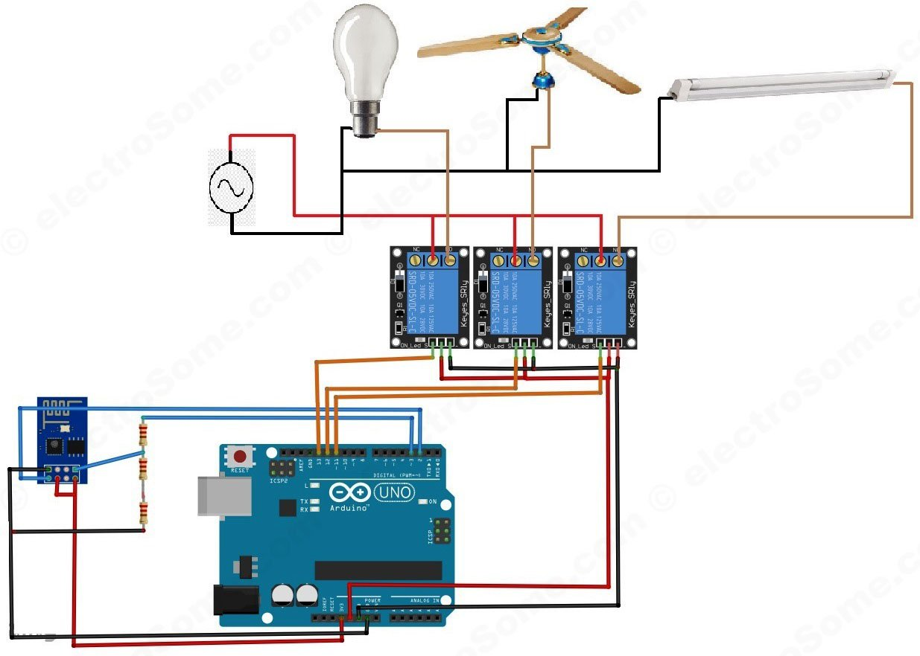
Connection of ARDUINO with ESP8266
Sept 23, 2017
Chartered Institute of Technology, Abu Road
17

Slide 8
Explanation
First we can connect ESP8266 with the Arduino Uno. The ESP8266 runs on 3.3V.
Connect the VCC and CH_PD of the ESP8266 to the 3.3V output pin of Arduino. CH_PD is Chip Power Down pin, which is active low. So we will give 3.3V to it, which will enable the chip. Then connect the TXD pin of the ESP8266 with the digital pin 2 of the Arduino. Then make a voltage divider to make 3.3V for the RXD of the ESP8266 which is connected to the pin 3 of Arduino. Here we are using software UART through digital pins 2 & 3 of Arduino. Lastly, connect the ground of the ESP8266 with the ground of the Arduino.
Now we can connect relays to Arduino. Connect three relays to pins 11, 12 and 13 of the Arduino. Also connect 5V and ground from the Arduino to power the relay. Note that here I am using relay modules which having built in transistor driver. So don’t forget to add driver when you are using bare relays. We can connect AC devices to the output terminals of those relays. First connect one wire (Phase) of the AC source with the common terminal (COM) of all relays and the second wire (Neutral) of AC source to one terminal of AC devices. Then connect the other terminal of AC devices to the NO (Normally Open) terminal of relays.
Sept 23, 2017
Chartered Institute of Technology, Abu Road
17

Slide 9
Program Coading
Sept 23, 2017
Chartered Institute of Technology, Abu Road
17

Slide 10
Explnation of CODE
The code is very long but easy to understand as it is well commented. First we will initialize the software uart with digital pins 2 & 3 of Arduino for the communication with ESP8266. After that we will initialize pins to which we will connect relays as output pins. Then we will configure ESP8266 in access point mode. Arduino + ESP8266 is programmed as a web server such that we can control those relays through a web browser.
Sept 23, 2017
Chartered Institute of Technology, Abu Road
17

Slide 11
HTML CODE
<html>
<head>
<title>Home Automation System</title> <!-- This will be the page title -->
</head>
<body> <!-- All the data in it will be shown on the page -->
<button id="11" class="led">Toggle Pin 11</button> <!-- This will create the button for pin 11 -->
<button id="12" class="led">Toggle Pin 12</button> <!-- This will create the button for pin 12 -->
<button id="13" class="led">Toggle Pin 13</button> <!-- This will create the button for pin 13 -->
<script src="jquery.min.js"></script> <!-- This will read the script from the jquery -->
<script type="text/javascript">
$(document).ready(function(){
$(".led").click(function(){
var p = $(this).attr('id'); // Getting the id value that which pin to toggle, pin 13 or pin 13 or pin 11
// Sending the request to the ip address of the server with the pin number to toggle the pin
$.get("http://192.168.4.1:80/", {pin:p}); // Sending the get request
});
});
</script>
</body>
</html>
Sept 23, 2017
Chartered Institute of Technology, Abu Road
17

Slide 12
Server Page
The above HTML code uses the open source JavaScript library JQuery, so we need to obtain that. Save it in the same directory where you are going to save the above HTML code. Save the JQuery library file as the jquery. min and the full name of the file will be “jquery.min.js”.
Then copy above HTML code in a file and save it as an HTML file, say ‘control.html’. You can open this HTML file in a web browser, which will looks as shown below.
Sept 23, 2017
Chartered Institute of Technology, Abu Road
17

Slide 13
Explanation of HTML CODE
Whenever a button is pressed in the web browser, a HTTP GET request is send to the Arduino-ESP8266 webserver to toggle a particular pin. In the Arduino code, it looks for the string “+IPD” again and again to check that if any request is coming or not. When it gets a request it reads the next character which is the connection id. Connection id is required to close the particular TCP connection after processing the request. Then it looks for the pin number to toggle by checking the character after the string “?pin=”. The Arduino then toggles that particular digital pin, which toggles the relay.
Sept 23, 2017
Chartered Institute of Technology, Abu Road
17

Slide 14
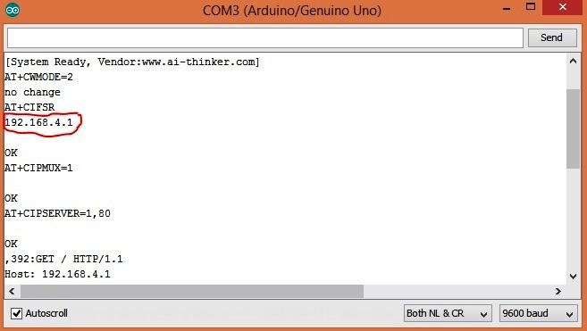
To Make In Work
After uploading the code to the Arduino, open the serial monitor from the Arduino IDE. It will show you the IP address as shown below.
First connect your system to the access point created by ESP8266 module (ESP_xxxxxx). Update the IP address in the control.html file created above. Now open the file using your web browser (Google Chrome or Mozilla Firefox). Now you can control your home appliances very easily.
Sept 23, 2017
Chartered Institute of Technology, Abu Road
17

Slide 15
Thank You
Sept 23, 2017
Chartered Institute of Technology, Abu Road
19

